Slide 1
Figure 1. Map of Chesapeake Bay. The red dots indicate the sampling locations.

Slide 2
Figure 2. Histogram of Chlorophyll a (a) and TSS (b) in linear scale. The skewness is 3.64 in (a) and 3.38 in (b).

Slide 3
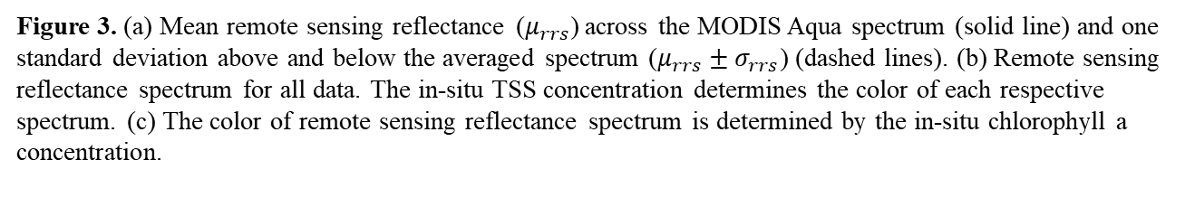
Figure 3. (a) Mean remote sensing reflectance ($μ_{rrs}$) across the MODIS Aqua spectrum (solid line) and one standard deviation above and below the averaged spectrum ($μ_{rrs}±σ_{rrs}$) (dashed lines). (b) Remote sensing reflectance spectrum for all data. The in-situ TSS concentration determines the color of each respective spectrum. (c) The color of remote sensing reflectance spectrum is determined by the in-situ chlorophyll a concentration.

Slide 4
Figure 4. Flow chart illustrating the training process of the algorithms (RVM, SVM, ANN, GLM).

Slide 5
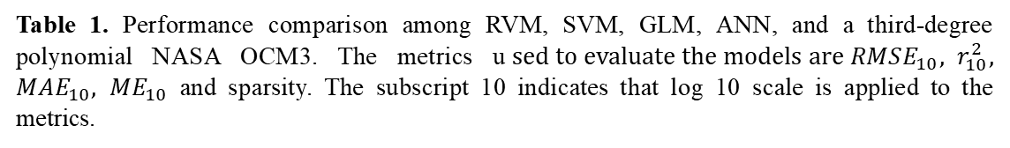
 | r2 | rmse | mae | mape | mean | Sparsity (AIC for glm, ann and [%]SVs/RVs for rvm, svr)
RVM | 0.507136 | 0.193571 | 0.150816 | 21.89352 | -0.01085 | 0.048896
SVM | 0.438381 | 0.207647 | 0.156018 | 24.37996 | -0.00894 | 0.491057
GLM | 0.479483 | 0.609159 | 0.568567 | 62.38176 | 0.567777 | 5276.447
ANN | 0.400995 | 0.275908 | 0.169618 | 24.84886 | -0.09235 | 2400.399
NASA OCM 3 | 0.08537 | 0.369847 | 0.28196 | 41.71656 | -0.13506
Table 1. Performance comparison among RVM, SVM, GLM, ANN, and a third-degree polynomial NASA OCM3. The metrics u$sed to evaluate the models are RMSE_{10}, r_{10}^{2}, MAE_{10}, ME_{10}$ and sparsity. The subscript 10 indicates that log 10 scale is applied to the metrics.

Slide 6
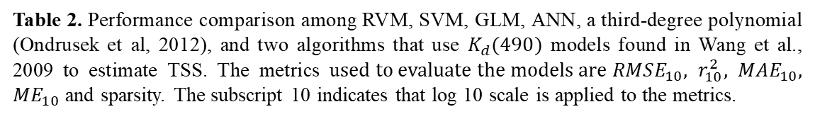
 | r2 | rmse | mae | mape | mean | Sparsity (AIC for glm, ann and [%] SVs/RVs for rvm, svr)
rvm | 0.483937 | 0.156619 | 0.116542 | 14.47409 | 0.02359 | 0.03
svm | 0.489838 | 0.155038 | 0.11622 | 14.43587 | 0.019208 | 0.61
glm | 0.508806 | 0.570622 | 0.54324 | 62.11267 | 0.54324 | 5416.366
ann | 0.05301 | 0.844489 | 0.460651 | 57.67394 | -0.4078 | 2422.67
Ondrusek et al., 2012 | 0.368696 | 0.188518 | 0.134756 | 16.3624 | 0.044767
Wang et al., 2009 with Eq. 9 | 0.336132 | 0.181204 | 0.140962 | 18.75948 | -0.04412
Wang et al., 2009 with Eq. 12 | 0.326843 | 0.182971 | 0.14256 | 18.88168 | -0.04276
Table 2. Performance comparison among RVM, SVM, GLM, ANN, a third-degree polynomial (Ondrusek et al, 2012), and two algorithms that use $K_{d}(490)$ models found in Wang et al., 2009 to estimate TSS. The metrics u$sed to evaluate the models are RMSE_{10}, r_{10}^{2}, MAE_{10}, ME_{10}$ and sparsity. The subscript 10 indicates that log 10 scale is applied to the metrics.

Slide 7
Figure 5. Scatter plots of the observed versus predicted TSS (log scale) for (a) SVR, (b) RVM, (c) GLM, (d) ANN, (e) Ondrusek et al. (2012) and (f) Wang (2009)’s models.

Slide 8
Figure 6. Scatter plots of the observed versus predicted chlorophyll a (log scale) for (a) SVR, (b) RVM, (c) GLM, (d) ANN, and (e) NASA OCM3.

Slide 9
Figure 7. Mean monthly in-situ TSS and predicted TSS obtained from the RVM, SVR, GLM, and ANN models for the upper, middle, and lower sections of the Chesapeake Bay.

Slide 10
Figure 8. Mean monthly in-situ chlorophyll a and predicted chlorophyll obtained from the RVM, SVR, GLM, and ANN models for the upper, middle, and lower sections of the Chesapeake Bay.

Slide 11
TSS RVM
Figure 9. Monthly TSS climatology obtained from the RVM model and monthly climatology of MODIS remote sensing reflectance measurements.

Slide 12
TSS SVM
Figure 10. Monthly TSS climatology obtained from the SVM model and monthly climatology of MODIS remote sensing reflectance measurements.

Slide 13
TSS GLM
Figure 11. Monthly TSS climatology obtained from the GLM model and monthly climatology of MODIS remote sensing reflectance measurements. The monthly climatology was rescaled.

Slide 14
TSS ANN
Figure 12. Monthly TSS climatology obtained from the ANN model and monthly climatology of MODIS remote sensing reflectance measurements. The monthly climatology was rescaled.

Slide 15
CHL RVM
Figure 13. Monthly chlorophyll a climatology obtained from the RVM model and monthly climatology of MODIS remote sensing reflectance measurements.

Slide 16
CHL SVM
Figure 14. Monthly chlorophyll a climatology obtained from the SVM model and monthly climatology of MODIS remote sensing reflectance measurements.

Slide 17
CHL GLM
Figure 15. Monthly chlorophyll a climatology obtained from the GLM model and monthly climatology of MODIS remote sensing reflectance measurements. The monthly climatology was rescaled.

Slide 18
CHL ANN
Figure 16. Monthly chlorophyll a climatology obtained from the ANN model and monthly climatology of MODIS remote sensing reflectance measurements. The monthly climatology was rescaled.

